Slide 1
Database Management System (MDS 505)
Jagdish Bhatta
Jagdish Bhatta

Slide 2
Unit-1
Fundamental Concept of DBMS: Data Models
Jagdish Bhatta
Notes:
Jagidsh Bhatta

Slide 3
Data Models
One fundamental characteristic of the database approach is that it provides some level of data abstraction.
Data abstraction generally refers to the suppression of details of data organization and storage, and the highlighting of the essential features for an improved understanding of data. One of the main characteristics of the database approach is to support data abstraction so that different users can perceive data at their preferred level of detail.
A data model—a collection of concepts that can be used to describe the structure of a database—provides the necessary means to achieve this abstraction. By structure of a database we mean the data types, relationships, and constraints that apply to the data. Most data models also include a set of basic operations for specifying retrievals and updates on the database.
Jagdish Bhatta

Slide 4
Data Models
Data model is a collection of tools for describing;
  Data
  Data relationships
  Data semantics
  Data constraints
Jagdish Bhatta

Slide 5
Data Models
High-level or conceptual data models provide concepts that are close to the way many users perceive data, whereas low-level or physical data models provide concepts that describe the details of how data is stored on the computer storage media, typically magnetic disks.
Concepts provided by physical data models are generally meant for computer specialists, not for end users. Between these two extremes is a class of representational (or implementation) data models, which provide concepts that may be easily understood by end users but that are not too far removed from the way data is organized in computer storage. Representational data models hide many details of data storage on disk but can be implemented on a computer system directly.
Jagdish Bhatta

Slide 6
Data Models
Conceptual data models use concepts such as entities, attributes, and relationships. An entity represents a real-world object or concept, such as an employee or a project in database. An attribute represents some property of interest that further describes an entity, such as the employee’s name or salary. A relationship among two or more entities represents an association among the entities, for example, a works-on relationship between an employee and a project. The entity–relationship model is a popular high-level conceptual data model.
Jagdish Bhatta

Slide 7
Data Models
Representational or implementation data models are the models used most frequently in traditional commercial DBMSs. These include the widely used relational data model, as well as the so-called legacy data models—the network and hierarchical models—that have been widely used in the past. Representational data models represent data by using record structures and hence are sometimes called record-based data models.
Jagdish Bhatta

Slide 8
Data Models
The object data model as an example of a new family of higher-level implementation data models that are closer to conceptual data models. A standard for object databases called the ODMG object model has been proposed by the Object Data Management Group (ODMG). Object data models are also frequently utilized as high-level conceptual models, particularly in the software engineering domain.
Physical data models describe how data is stored as files in the computer by representing information such as record formats, record orderings, and access paths. An access path is a search structure that makes the search for particular database records efficient, such as indexing or hashing. An index is an example of an access path that allows direct access to data using an index term or a keyword. It is similar to the index at the end of this text, except that it may be organized in a linear, hierarchical (tree-structured), or some other fashion.
Jagdish Bhatta

Slide 9
Data Models
Another class of data models is known as self-describing data models. The data storage in systems based on these models combines the description of the data with the data values themselves. In traditional DBMSs, the description (schema) is separated from the data.
These models include XML as well as many of the key-value stores and NOSQL systems that were recently created for managing big data.
Jagdish Bhatta

Slide 10

Hierarchical Data Model:
  A hierarchical database model is a data model in which the data is organized into a tree-like structure.
  The structure allows representing information using parent/child relationships: each parent can have many children, but each child has only one parent. All attributes of a specific record are listed under an entity type.
  Hierarchical database model rigidly structures data into an inverted “tree” in which each record contains two elements, a single root or master field, often called a key, and a variable number of subordinate fields.
Jagdish Bhatta

Slide 11

Hierarchical Data Model:
  The strongest advantage of the hierarchical database approach is the speed and efficiency with which it can be searched for data.
  The hierarchical model does have problems: Access to data in this model is predefined by the database administrator before the programs that access the data are written. Programmers must follow the hierarchy established by the data structure.
  It can not handle many to many relationship
Jagdish Bhatta

Slide 12
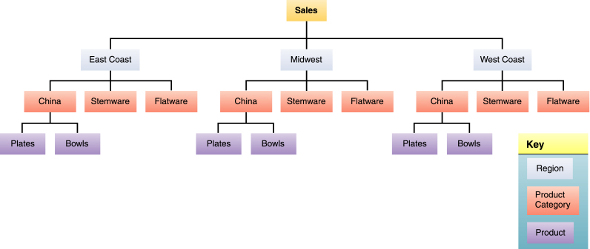
Hierarchical Data Model:
Jagdish Bhatta
Slide 1-<number>

Slide 13
Network Data Model:
  The network model is a database model conceived as a flexible way of representing objects and their relationships.
  Its distinguishing feature is that the schema, viewed as a graph in which object types are nodes and relationship types are arcs.
  Unlike hierarchical model, the network model allows each record to have multiple parent and child records, forming a lattice structure. The network model replaces the hierarchical tree with a graph thus allowing more general connections among the nodes. This model was evolved to specially handle non-hierarchical relationships. Now, same data may exist in two different levels.
Jagdish Bhatta

Slide 14
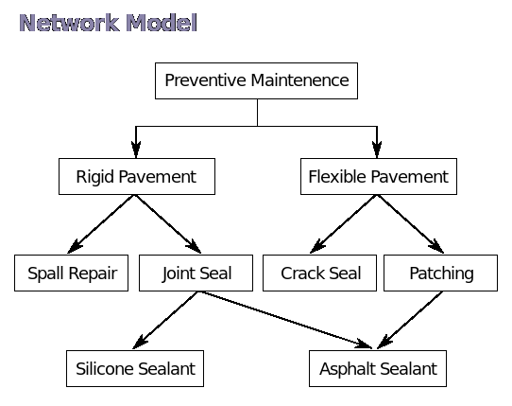
Network Data Model:
  Support many-to-many relationship
  Good processing speed but very complex model to design, implement and maintain
Jagdish Bhatta
Slide 1-<number>

Slide 15
Relational Data Model
  Relational data model represents the database as a collection of relations where each relation resembles a table of values with rows and columns.
  A relation may be regarded as a set of tuples, also called records. A relation consists of relation schema & relation instance. The relation schema specifies relation name & description of tuples (name of attributes, domain). While relation instance corresponds to a table of rows & columns where each row is a tuple & the column is the attribute.
  Major advantages of relational model over the older data models are the simple data representation & the ways complex queries can be expressed easily.
Jagdish Bhatta
Slide 1-<number>

Slide 16
Relational Data Model
  Consider a relation representing employee record as;
  Employee
  The relational model of data permits the database designer to create a consistent, logical representation of information. Consistency is achieved by including declared constraints in the database design, which is usually referred to as the logical schema. The theory includes a process of database normalization whereby a design with certain desirable properties can be selected from a set of logically equivalent alternatives
Eid | Name | Address | Depart_no
011 | Ram Sing | Kathmandu | D01
012 | Hari Saha | Pokhara | D02
Jagdish Bhatta
Slide 1-<number>

Slide 17

Fig: A Sample Relational Database
Jagdish Bhatta

Slide 18
The relational data model is the most widely used data model, and a vast majority of current database systems are based on the relational model. The relational model is at a lower level of abstraction than the E-R model. Database designs are often carried out in the E-R model, and then translated to the relational model.
Jagdish Bhatta

Slide 19
Entity-Relationship Model:
The entity-relationship (E-R) model is a high level data model based on a perception of a real world that consists of collection of basic objects, called entities, and of relationships among these entities. An entity is a thing or object in the real world that is distinguishable from other objects.
Entities are described in a database by a set of attributes. A relationship is an association among several entities. The set of all entities of the same type is called an entity set and the set of all relationships of the same type is called a relationship set.
Jagdish Bhatta

Slide 20
The overall logical structure of a database can be expressed graphically by an E-R diagram. The components of this diagram are:
• Rectangles (represent entity sets)
• Ellipses (represent attributes)
• Diamonds (represent relationship sets among entity sets)
• Lines (link attributes to entity sets and entity sets to relationship sets)
Jagdish Bhatta

Slide 21

Fig: A Sample E-R Diagram
Jagdish Bhatta

Slide 22
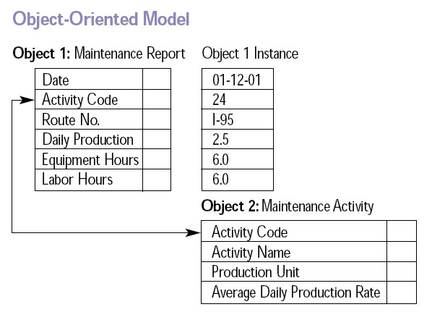
Object Oriented Database: An object database (also object-oriented data model) is a database model in which information is represented in the form of objects as used in object-oriented programming.
Data model that adds new object storage capabilities to relational databases.
Jagdish Bhatta

Slide 23
Schemas and Instances
The description of a database is called the database schema, which is specified during database design and is not expected to change frequently.
DB Schema
  captures attributes, relationships, constraints on the data
  is independent of any application program
Databases change over time as data is inserted and deleted. The collection of data stored in the database at a particular moment of time is called an instance of the database. Also known as DB State.
Jagdish Bhatta

Slide 24
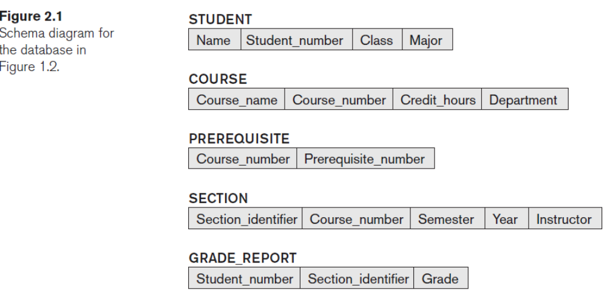
Schemas and Instances
Jagdish Bhatta

Slide 25

Example Of A Simple Database
Slide 1- <number>
Jagdish Bhatta

Slide 26
Schemas and Instances
A schema diagram displays only some aspects of a schema, such as the names of record types and data items, and some types of constraints. Other aspects are not specified in the schema diagram; for example, figure 2.1 (in slide number 23) shows neither the data type of each data item nor the relationships among the various files.
Jagdish Bhatta

Slide 27
Schemas and Instances
The actual data in a database may change quite frequently. For example, the database shown in Figure 1.2 (in slide number 24) changes every time we add a new student or enter a new grade. The data in the database at a particular moment in time is called a database state or snapshot. It is also called the current set of occurrences or instances in the database. In a given database state, each schema construct has its own current set of instances; for example, the STUDENT construct will contain the set of individual student entities (records) as its instances. Many database states can be constructed to correspond to a particular database schema. Every time we insert or delete a record or change the value of a data item in a record, we change one state of the database into another state.
Jagdish Bhatta

Slide 28
Schemas and Instances
The distinction between database schema and database state is very important. When we define a new database, we specify its database schema only to the DBMS. At this point, the corresponding database state is the empty state with no data. We get the initial state of the database when the database is first populated or loaded with the initial data. From then on, every time an update operation is applied to the database, we get another database state. At any point in time, the database has a current state.
The DBMS is partly responsible for ensuring that every state of the database is a valid state—that is, a state that satisfies the structure and constraints specified in the schema. Hence, specifying a correct schema to the DBMS is extremely important and the schema must be designed with utmost care. The DBMS stores the descriptions of the schema constructs and constraints—also called the meta-data—in the DBMS catalog so that DBMS software can refer to the schema whenever it needs to. The schema is sometimes called the intension, and a database state is called an extension of the schema.
Jagdish Bhatta

Slide 29
Schemas and Instances
Although, as mentioned earlier, the schema is not supposed to change frequently, it is not uncommon that changes occasionally need to be applied to the schema as the application requirements change. For example, we may decide that another data item needs to be stored for each record in a file, such as adding the Date_of_birth to the STUDENT schema in Figure 2.1 (in slide number 24). This is known as schema evolution. Most modern DBMSs include some operations for schema evolution that can be applied while the database is operational.
Jagdish Bhatta

Slide 30
Schemas and Instances
Logical Schema – the overall logical structure of the database
  Example: The database consists of information about a set of customers and accounts in a bank and the relationship between them
    Analogous to type information of a variable in a program
Physical schema– the overall physical structure of the database
Instance – the actual content of the database at a particular point in time
  Analogous to the value of a variable
Jagdish Bhatta

Slide 31
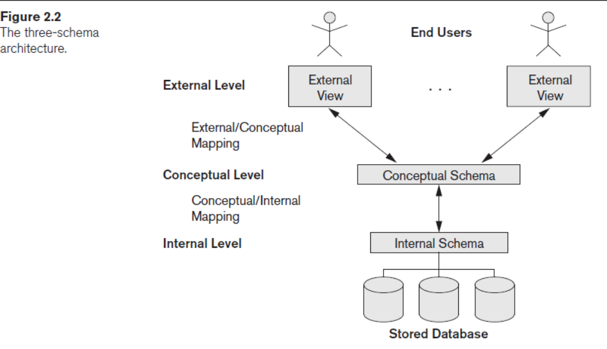
Three-Schema Architecture and Data Independence
It divides the system into three levels of abstraction: the internal or physical level, the conceptual level, and the external or view level.
The goal of the three schema architecture is to separate the user applications and the physical database.
Jagdish Bhatta

Slide 32
Three-Schema Architecture and Data Independence
The internal level has an internal schema, which describes the physical storage structure of the database. The internal schema uses a physical data model and describes the complete details of data storage and access paths for the database.
The conceptual level has a conceptual schema, which describes the structure of the whole database for a community of users. The conceptual schema hides the details of physical storage structures and concentrates on describing entities, data types, relationships, user operations, and constraints. Usually, a representational data model is used to describe the conceptual schema when a database system is implemented. This implementation conceptual schema is often based on a conceptual schema design in a high-level data model.
The external or view level includes a number of external schemas or user views. Each external schema describes the part of the database that a particular user group is interested in and hides the rest of the database from that user group. As in the previous level, each external schema is typically implemented using a representational data model, possibly based on an external schema design in a high-level conceptual data model.
Jagdish Bhatta

Slide 33
Three-Schema Architecture and Data Independence
The DBMS must transform a request specified on an external schema into a request against the conceptual schema, and then into a request on the internal schema for processing over the stored database. If the request is a database retrieval, the data extracted from the stored database must be reformatted to match the user’s external view. The processes of transforming requests and results between levels are called mappings.
Jagdish Bhatta

Slide 34
Levels of Abstraction
Physical level: describes how a record (e.g., instructor) is stored. It describes the physical storage structure of the data in the database.
Logical level: describes data stored in database, and the relationships among the data. It describes the structure of whole database and hides details of physical storage structure. It concentrates on describing entities, data types, relationships, attributes and constraints.
  type instructor = record
  ID : string;
  name : string;
  dept_name : string;
  salary : integer;
        end;
View level: application programs hide details of data types. It includes a number of user views and hence is guided by the end user requirement. It describes only those part of the database in which the users are interested and hides rest of all from those users. Views can also hide information (such as an employee’s salary) for security purposes.
Jagdish Bhatta

Slide 35
Data Independence
The three schema architecture further explains the concept of data independence, the capacity to change the schema at one level without having to change the schema at the next higher level.
  Logical Data Independence
  Physical Data Independence
Logical Data Independence: The capacity to change the conceptual schema without having to change the external schemas and their associated application programs. We may change the conceptual schema to expand the database (by adding a record type or data item), to change constraints, or to reduce the database (by removing a record type or data item).
Physical Data Independence: The capacity to change the internal schema without having to change the conceptual schema. Applications depends on logical schema. In general, the interfaces between the various levels and components should be well defined so that changes in some parts do not seriously influence others.
For example, the internal schema may be changed when certain file structures are reorganized or new indexes are created to improve database performance
Jagdish Bhatta

Slide 36
Data Independence…….
When a schema at a lower level is changed, only the mappings between this schema and higher-level schemas need to be changed in a DBMS that fully supports data independence. The higher-level schemas themselves are unchanged.
Hence, the application programs need not be changed since they refer to the external schemas.
Jagdish Bhatta

Slide 37
Database Languages
Database Language: Language used to interrogate and process data in a relational database
  Data definition language (DDL): Set of statements that describe a database structure (all record types and data set types). DDL statements include creating databases, tables etc. The DDL is used to specify the conceptual schema only.
  DCL (Data Control Language): DCL includes commands such as GRANT and REVOKE which mainly deal with the rights, permissions, and other controls of the database system.
  View Definition Language (VDL): to specify user views and their mappings to the conceptual schema, but in most DBMSs the DDL is used to define both conceptual and external schemas. In relational DBMSs, SQL is used in the role of VDL to define user or application views as results of predefined queries.
Jagdish Bhatta

Slide 38
Database Languages
  Data Manipulation Language (DML): Instructions used with higher-level programming languages to query the contents of the database, store or update information, and develop database applications. DML statements include accessing data from database.
  There are two main types of DMLs.
    High-level of non procedural
    Low-level or procedural
  A high-level or nonprocedural DML can be used on its own to specify complex database operations concisely. Many DBMSs allow high-level DML statements either to be entered interactively from a display monitor or terminal or to be embedded in a general-purpose programming language. In the latter case, DML statements must be identified within the program so that they can be extracted by a precompiler and processed by the DBMS.
Jagdish Bhatta

Slide 39
Database Languages
  A low level or procedural DML must be embedded in a general-purpose programming language. This type of DML typically retrieves individual records or objects from the database and processes each separately. Therefore, it needs to use programming language constructs, such as looping, to retrieve and process each record from a set of records. This type of DML typically retrieves individual records from the database and processes each separately. In this language, the looping, branching etc. Statements are used to retrieve and process each record from a set of records. Low-level DMLs are also called record-at-a-time DMLs because of this property. The programmers use the low-level DML.
  High-level DMLs, such as SQL, can specify and retrieve many records in a single DML statement; therefore, they are called set-at-a-time or set-oriented DMLs. A query in a high-level DML often specifies which data to retrieve rather than how to retrieve it; therefore, such languages are also called declarative.
Jagdish Bhatta

Slide 40
Database Languages
  Whenever DML commands, whether high level or low level, are embedded in a general-purpose programming language, that language is called the host language and the DML is called the data sublanguage.
  On the other hand, a high-level DML used in a standalone interactive manner is called a query language
Jagdish Bhatta

Slide 41
The Database System Environment
A database system is partitioned into modules that deal with each of the responsibilities of the overall system.
Jagdish Bhatta

Slide 42
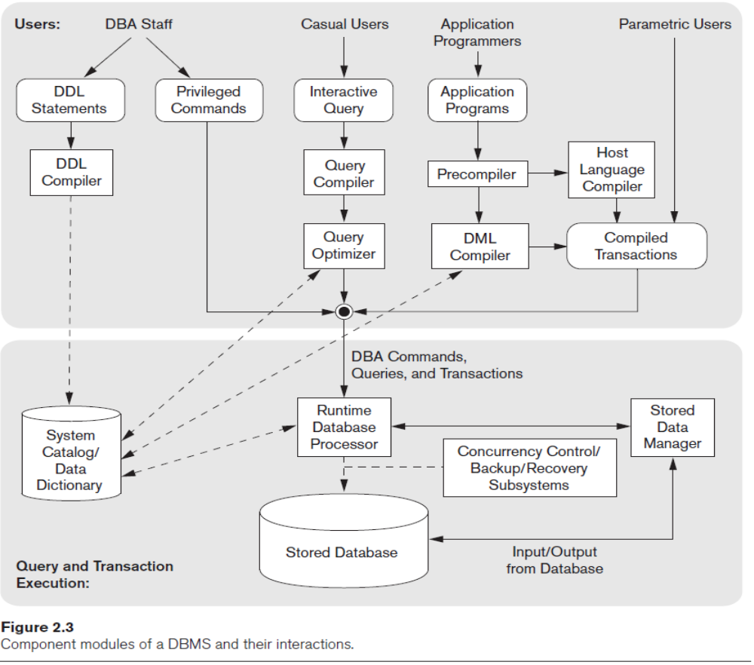
Database System Environment
Jagdish Bhatta

Slide 43
The Database System Environment
DBMS Component Modules:
The database and the DBMS catalog are usually stored on disk. Access to the disk is controlled primarily by the operating system (OS), which schedules disk read/write. Many DBMSs have their own buffer management module to schedule disk read/write, because management of buffer storage has a considerable effect on performance. Reducing disk read/write improves performance considerably. A higher-level stored data manager module of the DBMS controls access to DBMS information that is stored on disk, whether it is part of the database or the catalog.
The DDL compiler processes schema definitions, specified in the DDL, and stores descriptions of the schemas (meta-data) in the DBMS catalog. The catalog includes information such as the names and sizes of files, names and data types of data items, storage details of each file, mapping information among schemas, and constraints.
Casual users and persons with occasional need for information from the database interact using the interactive query interface. These queries are parsed and validated for correctness of the query syntax, the names of files and data elements, and so on by a query compiler that compiles into an internal form.
Jagdish Bhatta

Slide 44
The Database System Environment
DBMS Component Modules:
This internal query is subjected to query optimization. Among other things, the query optimizer is concerned with the rearrangement and possible reordering of operations, elimination of redundancies, and use of efficient search algorithms during execution.
Application programmers write programs in host languages such as Java, C, or C++ that are submitted to a precompiler. The precompiler extracts DML commands from an application program written in a host programming language. These commands are sent to the DML compiler for compilation into object code for database access. The rest of the program is sent to the host language compiler.
The runtime database processor executes (1) the privileged commands, (2) the executable query plans, and (3) the canned transactions with runtime parameters. It works with the system catalog and may update it with statistics. It also works with the stored data manager, which in turn uses basic operating system services for carrying out low-level input/output (read/write) operations between the disk and main memory. Concurrency control and backup and recovery systems are integrated into the working of the runtime database processor for purposes of transaction management.
Jagdish Bhatta

Slide 45
The Database System Environment
Database System Utilities: Most DBMSs have database utilities that help the DBA manage the database system.
  Loading. A loading utility is used to load existing data files—such as text files or sequential files—into the database. Usually, the current (source) format of the data file and the desired (target) database file structure are specified to the utility, which then automatically reformats the data and stores it in the database.
  Backup. A backup utility creates a backup copy of the database, usually by dumping the entire database onto tape or other mass storage medium. The backup copy can be used to restore the database in case of catastrophic disk failure.
  Database storage reorganization. This utility can be used to reorganize a set of database files into different file organizations and create new access paths to improve performance.
  Performance monitoring. Such a utility monitors database usage and provides statistics to the DBA. The DBA uses the statistics in making decisions such as whether or not to reorganize files or whether to add or drop indexes to improve performance.
Jagdish Bhatta

Slide 46
The Database System Environment
Tools, Application Environments, and Communications Facilities: Other tools are often available to database designers, users, and the DBMS.
  CASE tools are used in the design phase of database systems
  Another tool that can be quite useful in large organizations is an expanded data dictionary (or data repository) system. In addition to storing catalog information about schemas and constraints, the data dictionary stores other information, such as design decisions, usage standards, application program descriptions, and user information. Such a system is also called an information repository.
Application development environments, such as PowerBuilder (Sybase) or JBuilder (Borland), have been quite popular. These systems provide an environment for developing database applications and include facilities that help in many facets of database systems, including database design, GUI development, querying and updating, and application program development.
The DBMS also needs to interface with communications software, whose function is to allow users at locations remote from the database system site to access the database through computer terminals, workstations, or personal computers
Jagdish Bhatta

Slide 47
Centralized and Client/Server Architectures for DBMSs
Database systems structure:
  Centralized databases
    One to a few cores, shared memory
  Client-server,
    One server machine executes work on behalf of multiple client machines.
Jagdish Bhatta

Slide 48
Centralized and Client/Server Architectures for DBMSs
Centralized Database: The DBMS itself was still a centralized DBMS in which all the DBMS functionality, application program execution, and user interface processing were carried out on one machine.
Jagdish Bhatta

Slide 49
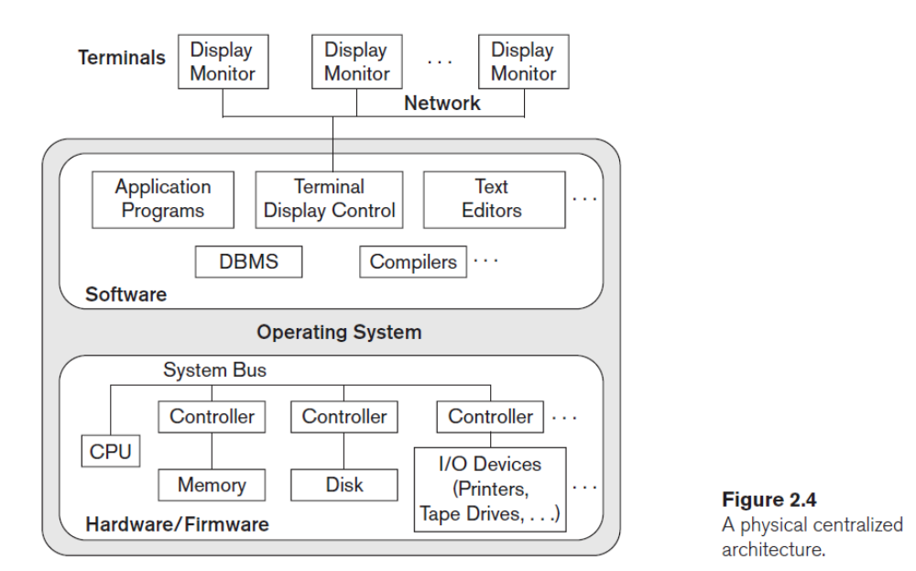
Centralized and Client/Server Architectures for DBMSs
Jagdish Bhatta

Slide 50
Centralized and Client/Server Architectures for DBMSs
Basic Client Server Architecture:
The client/server architecture was developed to deal with computing environments in which a large number of PCs, workstations, file servers, printers, database servers, Web servers, e-mail servers, and other software and equipment are connected via a network.
The idea is to define specialized servers with specific functionalities. For example, it is possible to connect a number of PCs or small workstations as clients to a file server that maintains the files of the client machines. Another machine can be designated as a printer server by being connected to various printers; all print requests by the clients are forwarded to this machine.
Web servers or e-mail servers also fall into the specialized server category.
Jagdish Bhatta

Slide 51
Centralized and Client/Server Architectures for DBMSs
Basic Client Server Architecture:
The resources provided by specialized servers can be accessed by many client machines. The client machines provide the user with the appropriate interfaces to utilize these servers, as well as with local processing power to run local applications.
A client in this framework is typically a user machine that provides user interface capabilities and local processing. When a client requires access to additional functionality—such as database access—that does not exist at the client, it connects to a server that provides the needed functionality. A server is a system containing both hardware and software that can provide services to the client machines, such as file access, printing, archiving, or database access.
Jagdish Bhatta

Slide 52
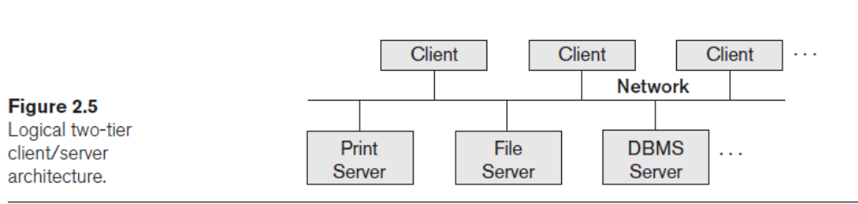
Centralized and Client/Server Architectures for DBMSs
Basic Client Server Architecture:
Jagdish Bhatta

Slide 53
Centralized and Client/Server Architectures for DBMSs
Underlying client/server framework database applications are usually partitioned into two, three or n-parts.
  Two-tier architecture -- the application resides at the client machine, where it invokes database system functionality at the server machine
  The user interface programs and application programs can run on the client side. When DBMS access is required, the program establishes a connection to the DBMS (which is on the server side); once the connection is created, the client program can communicate with the DBMS.
Jagdish Bhatta

Slide 54
Centralized and Client/Server Architectures for DBMSs
  Three-tier architecture -- the client machine acts as a front end and does not contain any direct database calls. The client end communicates with an application server, usually through a forms interface. The application server in turn communicates with a database system to access data.
  This intermediate layer or middle tier is called the application server or the Web server, depending on the application. This server plays an intermediary role by running application programs and storing business rules (procedures or constraints) that are used to access data from the database server. It can also improve database security by checking a client’s credentials before forwarding a request to the database server. Clients contain user interfaces and web browsers. The intermediate server accepts requests from the client, processes the request and sends database queries and commands to the database server, and then acts as a conduit for passing (partially) processed data from the database server to the clients, where it may be processed further and filtered to be presented to the users. Thus, the user interface, application rules, and data access act as the three tiers.
Jagdish Bhatta

Slide 55
Client/Server Database Architecture
  n-tier architecture -- the client machine acts as a front end and does not contain any direct database calls.
    The client end communicates with an application server, usually through a forms interface.
    The application server in turn communicates with n-tiers/layers of servers
Jagdish Bhatta

Slide 56
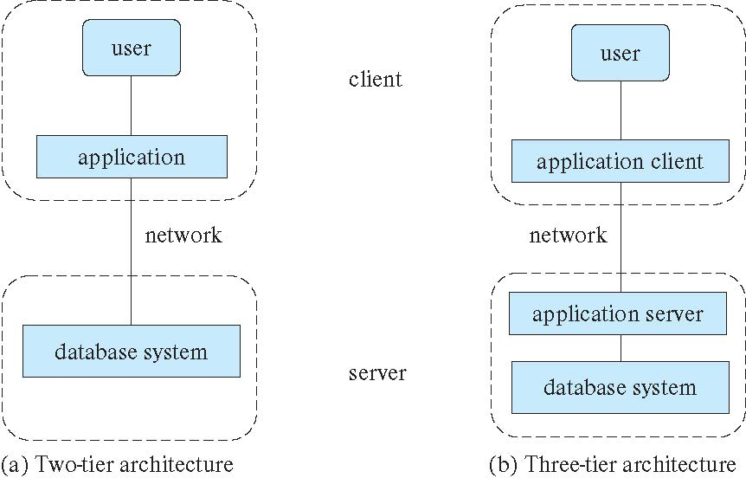
Two-tier and three-tier architectures
Jagdish Bhatta

Slide 57
Relational Algebra
The relational algebra is a procedural query language. A relational algebra query describes a procedure for computing the output relation from the input relations by applying the relational algebra operators.
The relational algebra defines a set of operators from set theory as Union, Intersection, Set Difference, Cartesian Product. Similarly, other operations as Select, Project & Join are incorporated with in the algebra operations. These operations can be categorized as unary or binary according as the number of relation on which they operate on.
Importance of Relational Algebra:
The relational algebra is very important for several reasons:
  First, it provides a formal foundation for relational model operations.
  Second and perhaps more important, it is used as a basis for implementing and optimizing queries in relational DBMS (RDBMS).
  Third, some of its concepts are incorporated into the SQL standard query language for RDBMS
Jagdish Bhatta
Notes:
Jagidsh Bhatta

Slide 58
Relational Algebra
The relational algebra is a procedural query language. A relational algebra query describes a procedure for computing the output relation from the input relations by applying the relational algebra operators.
The relational algebra defines a set of operators from set theory as Union, Intersection, Set Difference, Cartesian Product. Similarly, other operations as Select, Project & Join are incorporated with in the algebra operations. These operations can be categorized as unary or binary according as the number of relation on which they operate on.
Importance of Relational Algebra:
The relational algebra is very important for several reasons:
  First, it provides a formal foundation for relational model operations.
  Second and perhaps more important, it is used as a basis for implementing and optimizing queries in relational DBMS (RDBMS).
  Third, some of its concepts are incorporated into the SQL standard query language for RDBMS
Jagdish Bhatta
Notes:
Jagidsh Bhatta

Slide 59
Codd’s Rule
Dr Edgar F. Codd, after his extensive research on the Relational Model of database systems, came up with twelve rules of his own, which according to him, a database must obey in order to be regarded as a true relational database.
Rule 1: Information Rule
  The data stored in a database, may it be user data or metadata, must be a value of some table cell. Everything in a database must be stored in a table format.
Rule 2: Guaranteed Access Rule
  Every single data element (value) is guaranteed to be accessible logically with a combination of table-name, primary-key (row value), and attribute-name (column value). No other means, such as pointers, can be used to access data.
Rule 3: Systematic Treatment of NULL Values
  The NULL values in a database must be given a systematic and uniform treatment. This is a very important rule because a NULL can be interpreted as one the following − data is missing, data is not known, or data is not applicable.
Jagdish Bhatta
Notes:
Jagidsh Bhatta

Slide 60
Codd’s Rule
Rule 4: Active Online Catalog
  The structure description of the entire database must be stored in an online catalog, known as data dictionary, which can be accessed by authorized users. Users can use the same query language to access the catalog which they use to access the database itself.
Rule 5: Comprehensive Data Sub-Language Rule
  A database can only be accessed using a language having linear syntax that supports data definition, data manipulation, and transaction management operations. This language can be used directly or by means of some application. If the database allows access to data without any help of this language, then it is considered as a violation.
Rule 6: View Updating Rule
  All the views of a database, which can theoretically be updated, must also be updatable by the system
Jagdish Bhatta
Notes:
Jagidsh Bhatta

Slide 61
Codd’s Rule
Rule 7: High-Level Insert, Update, and Delete Rule
  A database must support high-level insertion, updation, and deletion. This must not be limited to a single row, that is, it must also support union, intersection and minus operations to yield sets of data records.
Rule 8: Physical Data Independence
  The data stored in a database must be independent of the applications that access the database. Any change in the physical structure of a database must not have any impact on how the data is being accessed by external applications.
Rule 9: Logical Data Independence
  The logical data in a database must be independent of its user’s view (application). Any change in logical data must not affect the applications using it. For example, if two tables are merged or one is split into two different tables, there should be no impact or change on the user application.
Jagdish Bhatta
Notes:
Jagidsh Bhatta

Slide 62
Codd’s Rule
Rule 10: Integrity Independence
  A database must be independent of the application that uses it. All its integrity constraints can be independently modified without the need of any change in the application. This rule makes a database independent of the front-end application and its interface.
Rule 11: Distribution Independence
  The end-user must not be able to see that the data is distributed over various locations. Users should always get the impression that the data is located at one site only. This rule has been regarded as the foundation of distributed database systems.
Rule 12: Non-Subversion Rule
  If a system has an interface that provides access to low-level records, then the interface must not be able to subvert the system and bypass security and integrity constraints.
Jagdish Bhatta
Notes:
Jagidsh Bhatta

